Slide 1
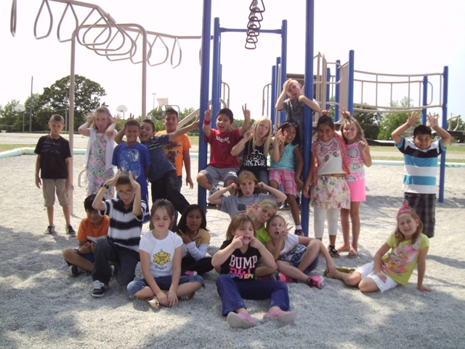
Mrs. Roughton’s Awesome 3rd Grade
Class Dictionary
2012~2013

Slide 2
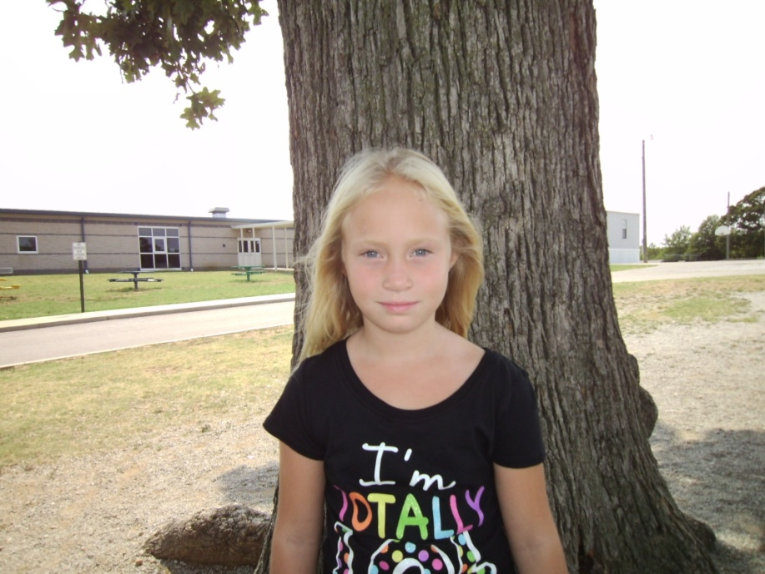
Madisen Elizbeth Lee Althof
Age:8
Birthday:April 25
Family:Mom sister stepdad
My hobbies are:Walking Swiming

Slide 3
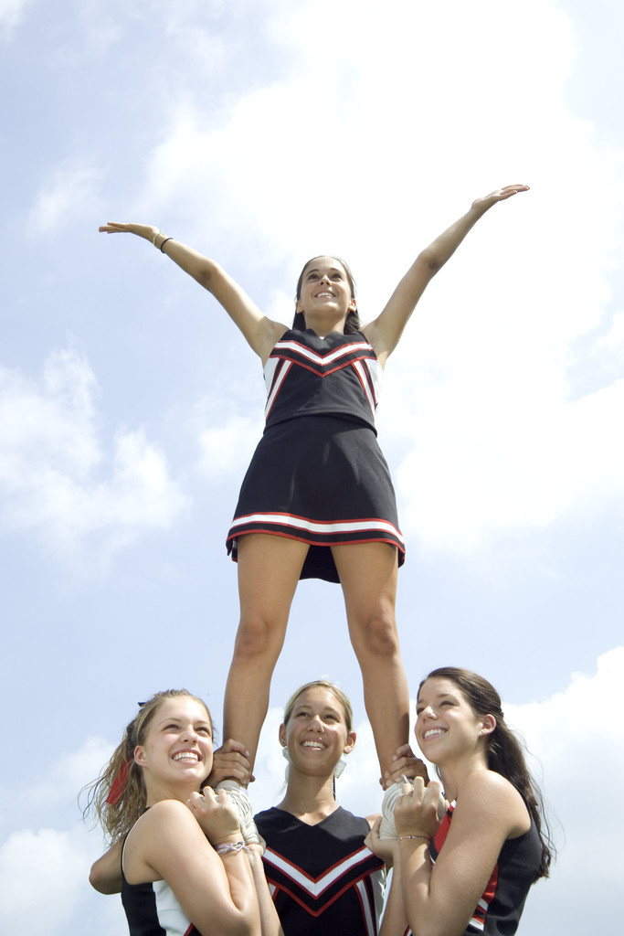
My favorite food is:Pie
My favorite color:Blue Green
My favorite subject is:School
When I grow up I want to be:Cheerleader Coach
I love it when my parents:Give me ice cream
I hate it when my parents:Say im grouned
My pet peeve is:Sister
The best thing about me is:Do cheerleading

Slide 4
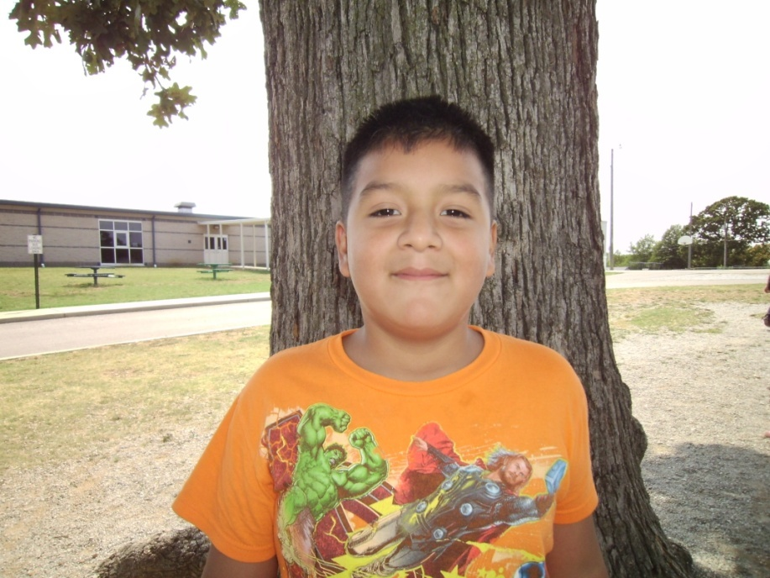
Bryant Arias Ramirez
Age:8
Birthday:June 26
Family:little sister ,dad,mom
My hobbies are:riding my bike playing video games

Slide 5
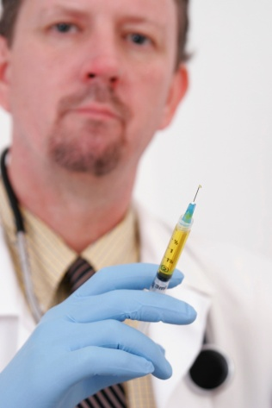
My favorite food is:oranges.
My favorite color:Blue
My favorite subject is:Social Studies.
When I grow up I want to be:a docter.
I love it when my parents:bring me to chuck,e,cheeses.
I hate it when my parents:let me fold clothes and put them back.
My pet peeve is:when my sister always bothers me
The best thing about me is:I am smart.

Slide 6
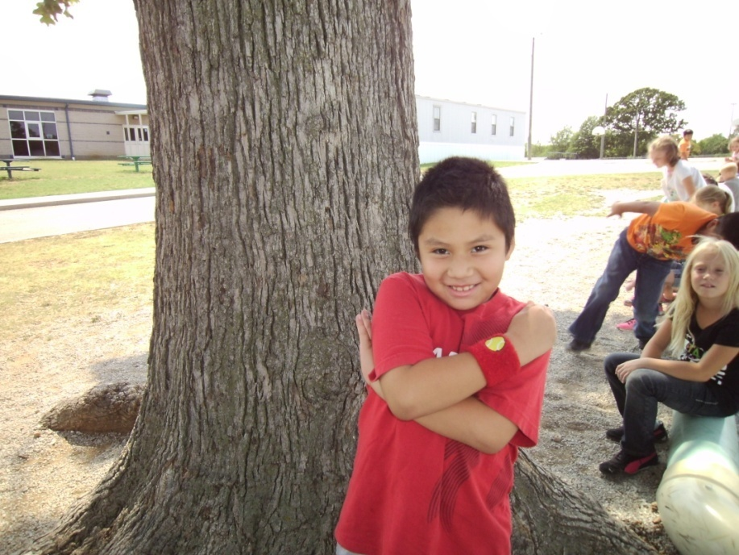
Oscar Chavez Mardia
Age:8
Birthday:november10
Family:momdadbrothers
My hobbies are:playmyxbox306

Slide 7
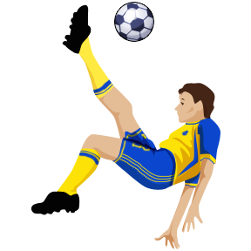
My favorite food is:pizza
My favorite color:red
My favorite subject is:math
When I grow up I want to be a docter
I love it when my parents:tack me chuckycheese
I hate it when my parents:hit me
My pet peeve is:when my brothers
The best thing about me I am good at soocer

Slide 8
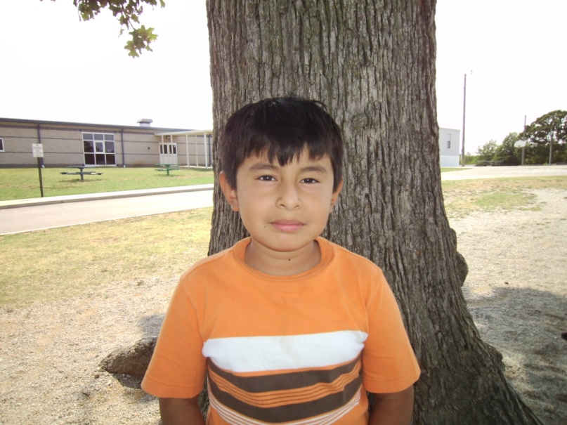
Esvin
Age:8
Birthday:february
Family:9
My hobbies are:play

Slide 9
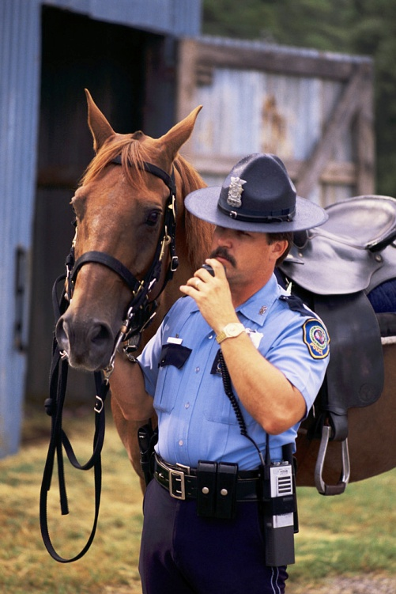
My favorite food is:pizza
My favorite color:blue
My favorite subject is:math
When I grow up I want to be:police
I love it when my parents: do my birthday
I hate it when my parents:don:t take me outside.
My pet peeve is:my sister bothers me
The best thing about me is:that I know how to play soccer.

Slide 10
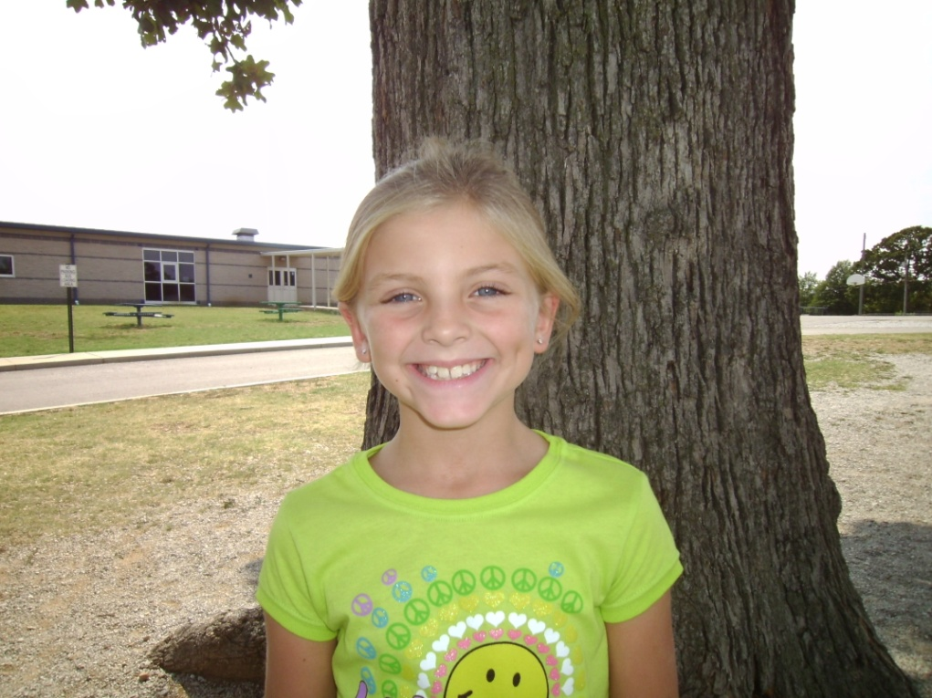
Sydnee Shannon Dudolski
Age:8
Birthday:April 22
Family:Mom and Dad ashley amanda karson
My hobbies are:playing volleyball and spending time with my family

Slide 11
My favorite food is:mac and cheese
My favorite color:blue
My favorite subject is:reading
When I grow up I want to be:teacher
I love it when my parents:are happy
I hate it when my parents:are mad
My pet peeve is:my brother
The best thing about me is:I’m a good volleyball player

Slide 12
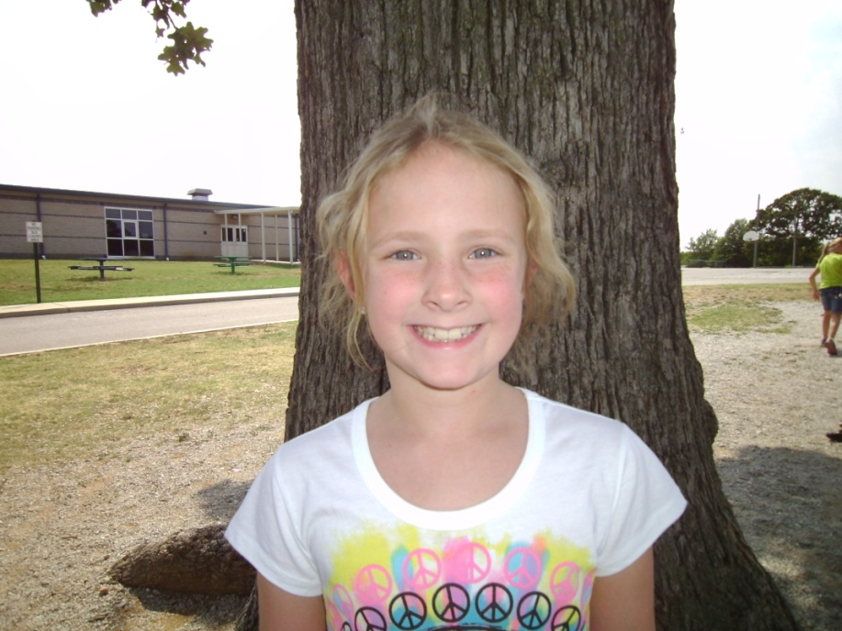
Jensyn Faith Elder
Age:8
Birthday:february 23 2004
Family: Mom Dad Kim Caleb Jaxon Jayden Rilly
My hobbies are: climing trees

Slide 13
My favorite food is:strawberries
My favorite color: blue and green
My favorite subject is: reading and math
When I grow up I want to be: olympic gymmist
I love it when my parents: let me fold landry
I hate it when my parents: say I cant a friend over
My pet peeve is: when my brother says h.p
The best thing about me is:I have a family

Slide 14
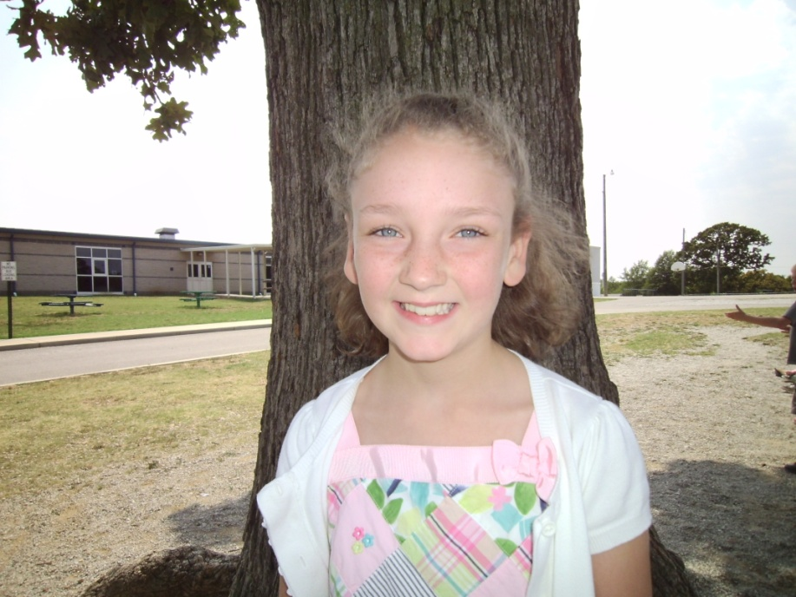
Claire frischenmeyer
Age:8
Birthday:october 22
Family:mom dad alyssa jj
My hobbies are:playing my 3ds and riding my bike.

Slide 15
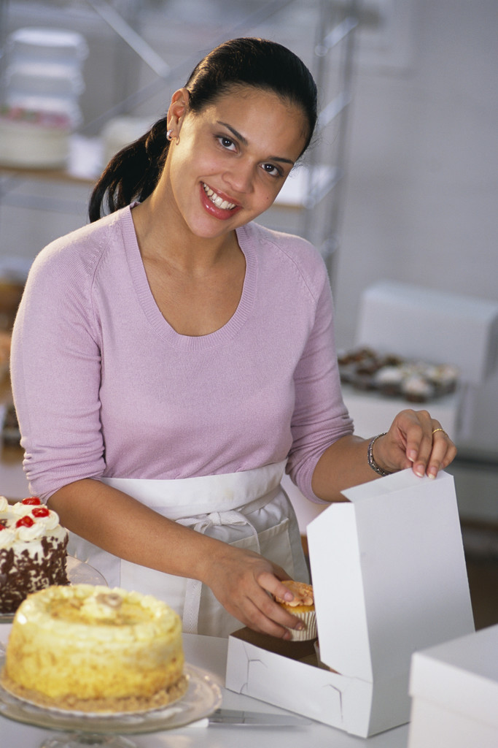
My favorite food is: cheetos and sandwiches
My favorite color: purple and pink
My favorite subject is: math
When I grow up I want to be: cake baker
I love it when my parents: take me out to dinner.
I hate it when my parents: clean my room
My pet peeve is: my sister
The best thing about me is: I like dancing.

Slide 16
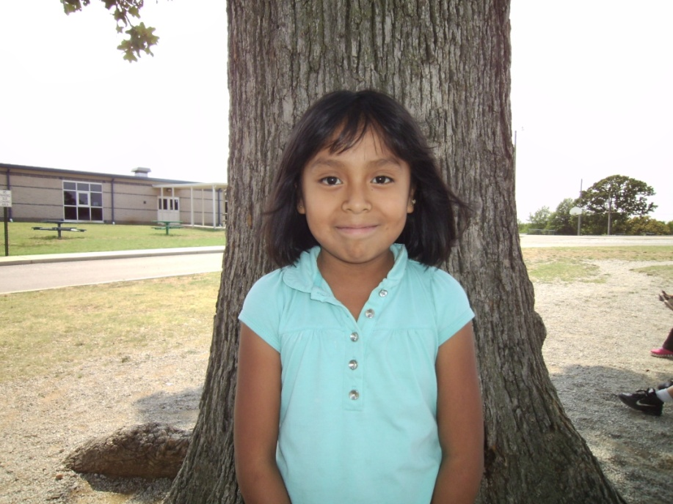
Yasny gonzalez
Age:8
Birthday:april2
Family:zumla carlos alexis franckiln
My hobbies are:swimming

Slide 17
My favorite food is:grapes
My favorite color:blue and green
My favorite subject is:reading
When I grow up I want to be:teacher
I love it when my parents:hug and kiss me
I hate it when my parents:hit me
My pet peeve is:my cosien
The best thing about me is:having fun

Slide 18
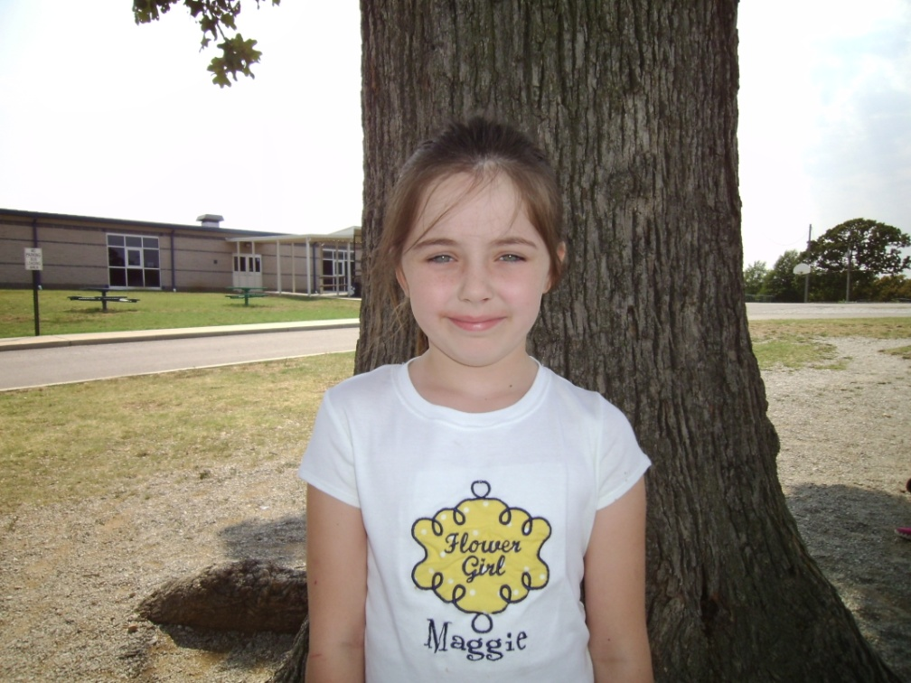
Maggie houston
Age:8
Birthday:march,3
Family:granny papa brother sister couison
My hobbies are:play games and help my mom cook

Slide 19
My favorite food is: strawberries
My favorite color:pink
My favorite subject is:math
When I grow up I want to be:teacher
I love it when my parents:jump on the bed
I hate it when my parents:tell me to take out the trash
My pet peeve is:I don’t like when he smacks his teeth when he eats
The best thing about me is:i’m good at school

Slide 20
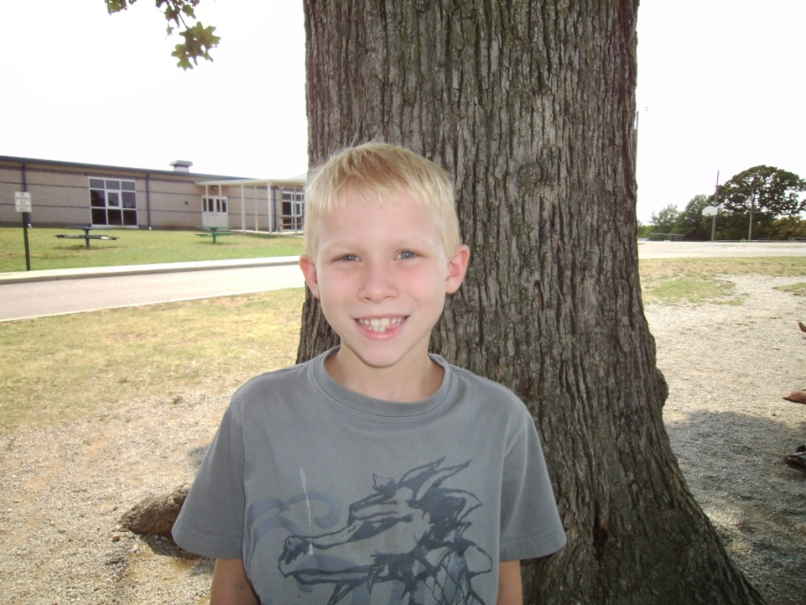
Richard William Jim Johnson
Age:8
Birthday: March 2
Family: Shelly (mom), Rich (dad), Michael
My hobbies are: playing war and video games

Slide 21
My favorite food is: recees
My favorite color: green
My favorite subject is: math
When I grow up I want to be: Plumber
I love it when my parents: let me play the xBox
I hate it when my parents: spank me
My pet peeve is: everyone tattles on me
The best thing about me is: I’m good at Outfit

Slide 22
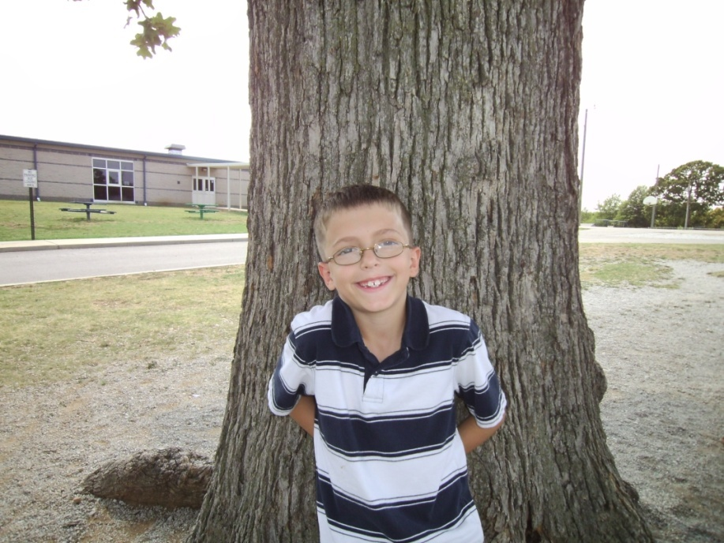
Klayton kollmeyer
Age:8
Birthday:may,1
Family:mom,brother sister.
My hobbies are:dancing drawing

Slide 23
My favorite food is:sushi
My favorite color:blue
My favorite subject is:math
When I grow up I want to be:a solider
I love it when my parents:you get a movie
I hate it when my parents:grond me. My pet peeve is:when my sister eats my ice cream
The best thing about me is:I love dancing

Slide 24
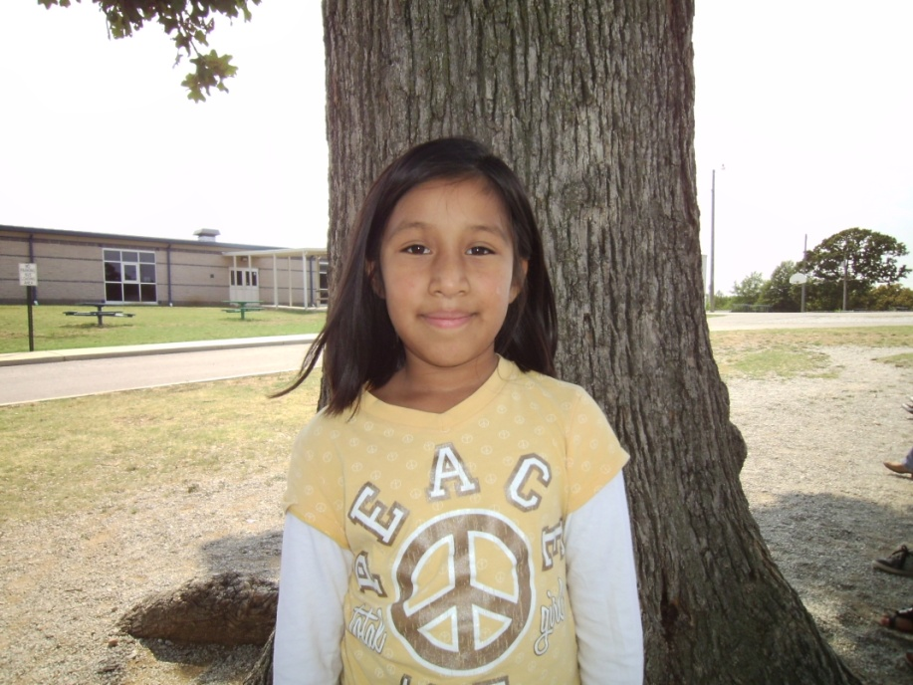
Jennifer lopez guzman
Age:8
Birthday:november28
Family:amos lorena chris
My hobbies are:swiming shopping

Slide 25
My favorite food is:eggs
My favorite color:blue
My favorite subject is:math
When I grow up I want to be:olympic runner
I love it when my parents:let me play
I hate it when my parents hate me
My pet peeve is:my brother screams
The best thing about me is:that I like blue

Slide 26
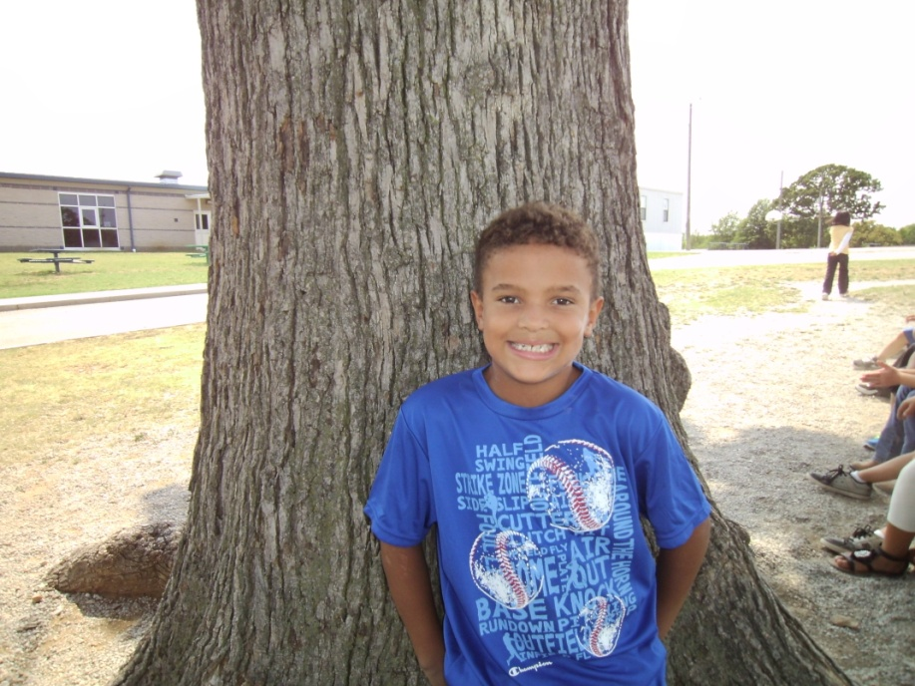
Dante
Age:8
Birthday : July 7
Family: Misty Santee Greenlee Whitney
My hobbies are: I like to play on my computer and I like to go swimming

Slide 27
My favorite food is: Biscuit gravy
My favorite color: Blue
My favorite subject is: Science
When I grow up I want to be: a soldier
I love it when my parents: Buy me stuff
I hate it when my parents: Don’t buy me stuff
My pet peeve is: a dog
The best thing about me is: I get to do a lot of stuff

Slide 28
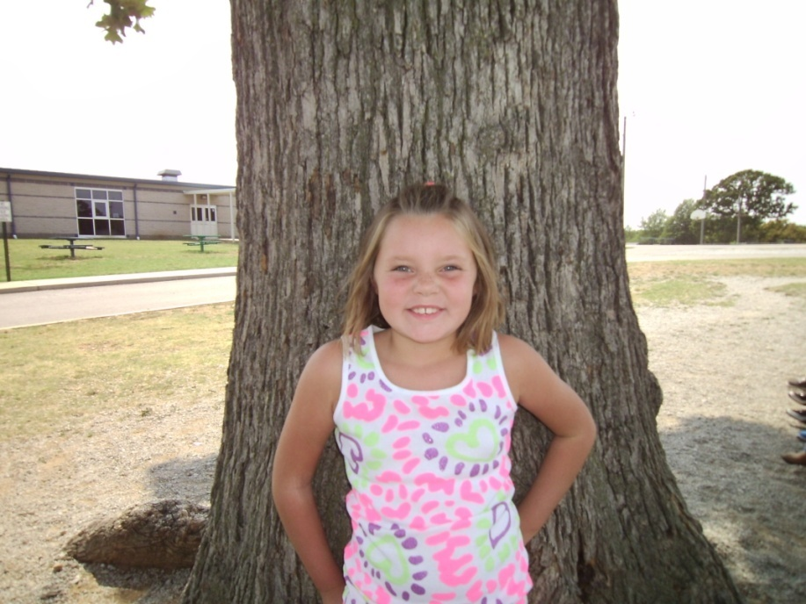
Grace Carol Pickering
Age:8
Birthday: June 21
Family: Mom and Dad
My hobbies are: Volleyball and Swimming

Slide 29
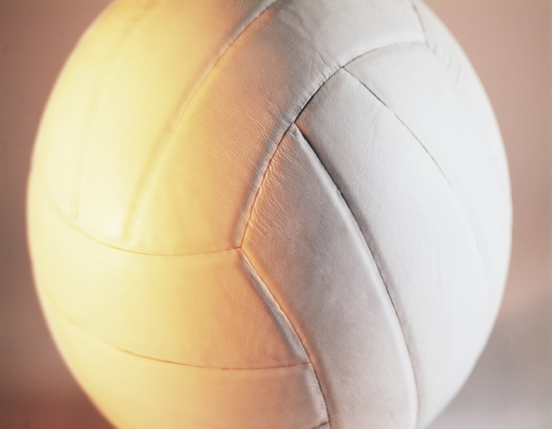
My favorite food is: Mexican
My favorite color: Purple
My favorite subject is: Math
When I grow up I want to be: Teacher
I love it when my parents: Take me to get ice cream
I hate it when my parents: Make me clean my room
My pet peeve is: My cousin sometimes
The best thing about me is: I have a nice family

Slide 30
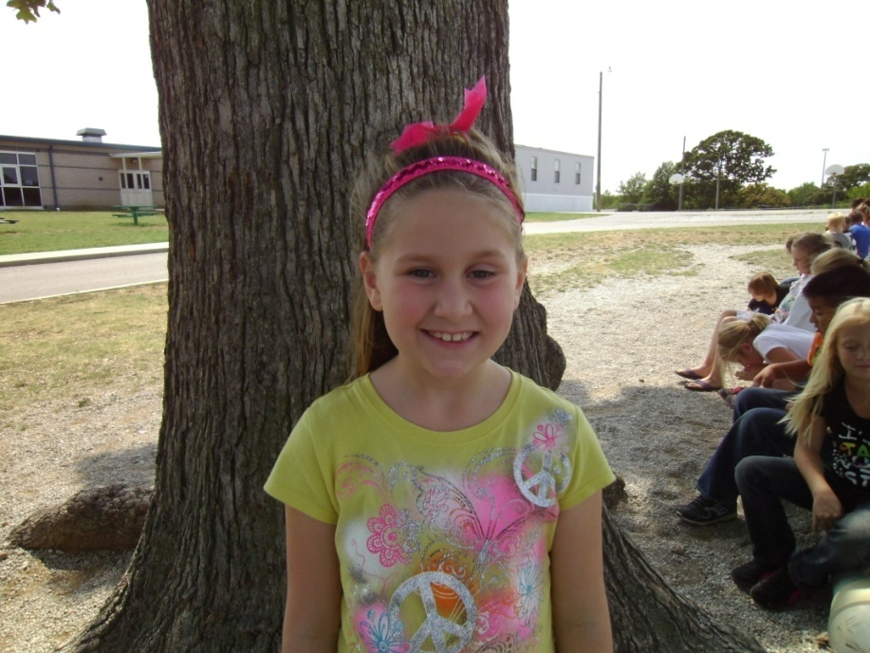
Clare Elisebeth Jean Priddy
Age:8
Birthday:june2
Family:mom dad brothers
My hobbies are:swimming ,bikriding

Slide 31
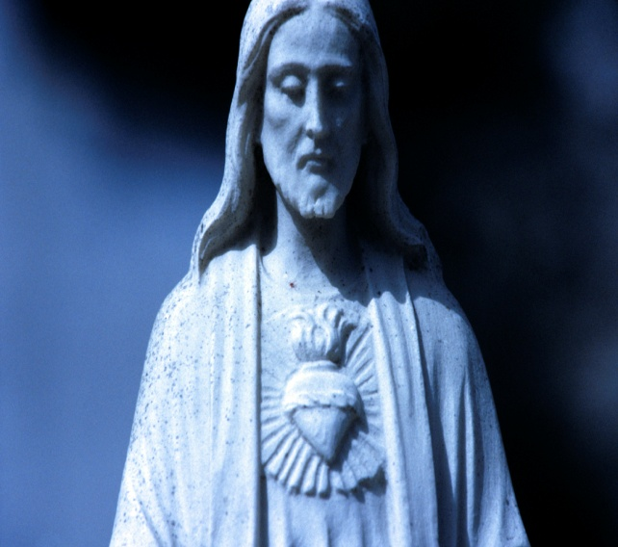
My favorite food is:lemon chicen
My favorite color:pink
My favorite subject is:math
When I grow up I want to be:vet
I love it when my parents:buy me stuff
I hate it when my parents:argu
My pet peeve is:when ben throus stuff at me
The best thing about me is:my heart

Slide 32
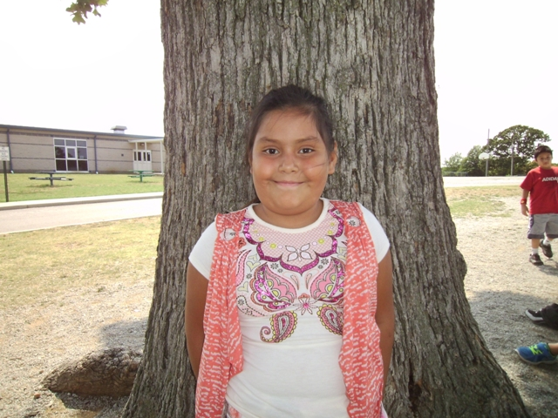
Jenifer Reyes
Age:8
Birthday:september 30
Family:magdalena andreskevin
My hobbies are:go swming play doter

Slide 33
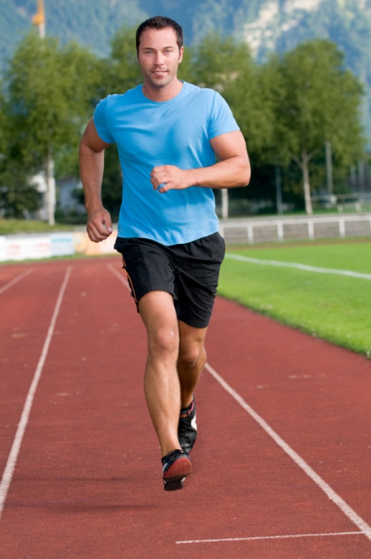
My favorite food is:chinese
My favorite color:all of tmem
My favorite subject is:math
When I grow up I want to be:doter
I love it when my parents:cook dinner
I hate it when my parents:make clan my room
My pet peeve is:my brother
The best thing about me is:running

Slide 34
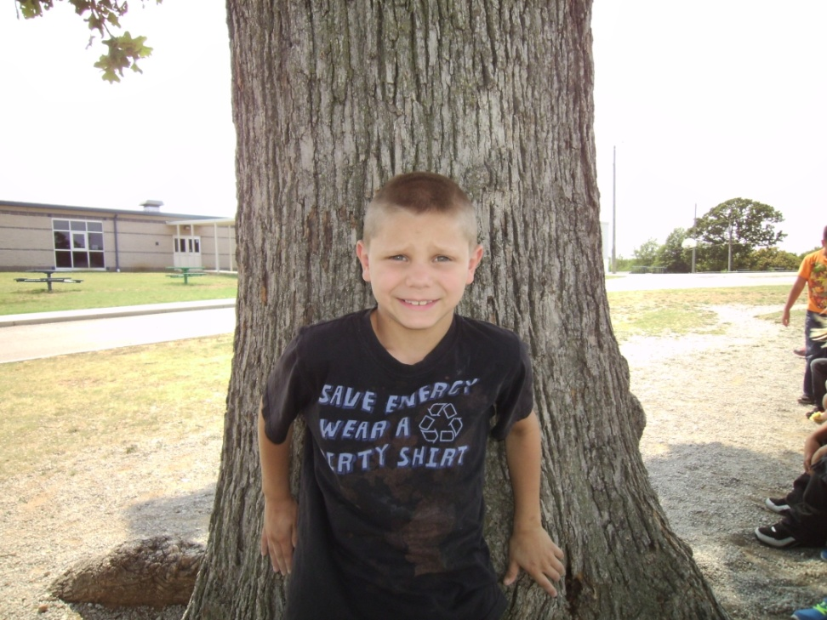
Ashton
Age:7
Birthday:October 15
Family:mom dad brother sister
My hobbies are:baseball and soccer

Slide 35
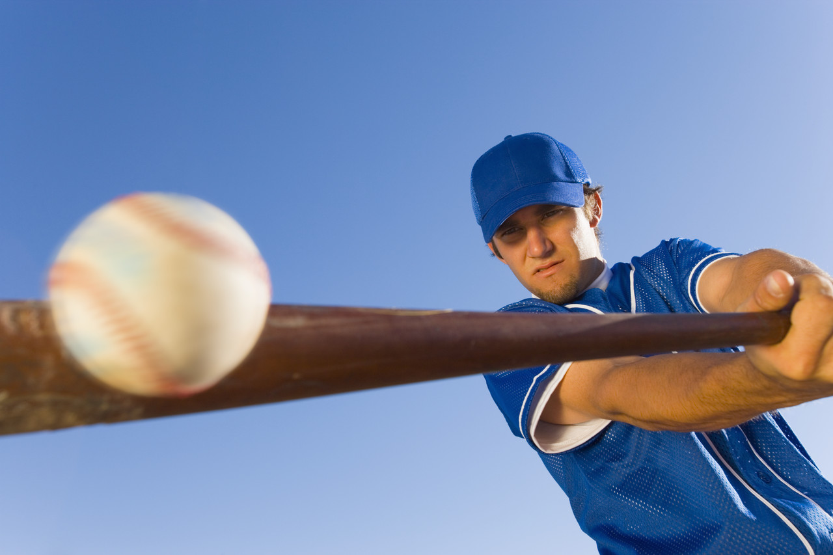
My favorite food is: pizza
My favorite color: blue
My favorite subject is: science
When I grow up I want to be: worker man
I love it when my parents: give me ice cream
I hate it when my parents: put me in my bedroom
My pet peeve is: my sisters tattle on me
The best thing about me is: Igood at stuff

Slide 36
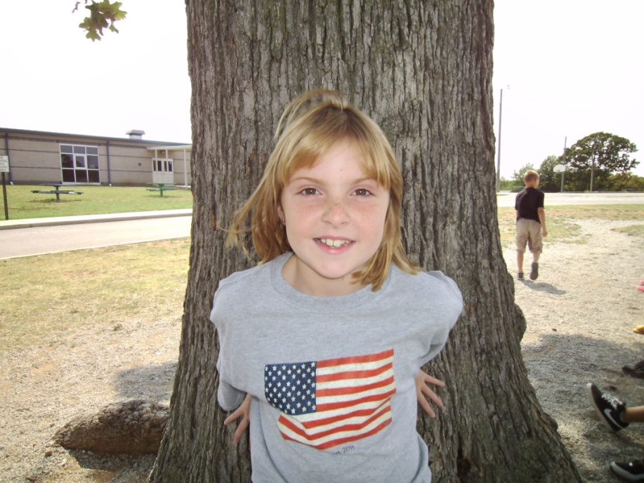
Cassidy Lynn Sherrill
Age:9
Birthday:August 6
Family:Mom Dad Brother Sister brother
My hobbies are:skating swiming

Slide 37
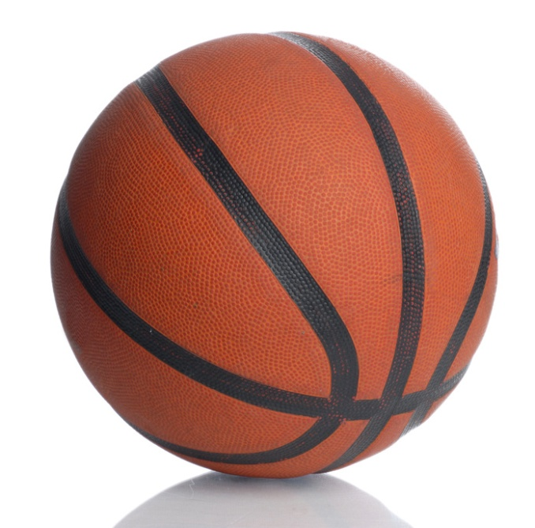
My favorite food is:pizza
My favorite color:camo
My favorite subject is:math
When I grow up I want to be:a parametic
I love it when my parents:spend time with me
I hate it when my parents:don’t give me what I want
My pet peeve is:when trevor screms at me
The best thing about me is:that I love to go hunting, bolling and love to play basketball

Slide 38
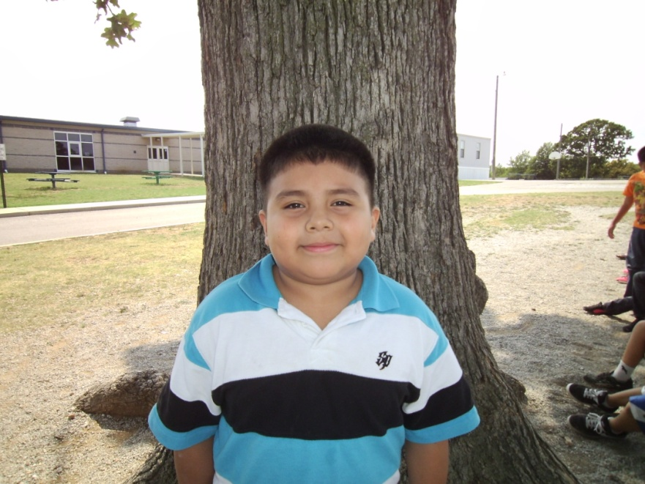
Bryan tebalan jaurez
Age:8
Birthday:march 20
Family:silva jocelyn odales
My hobbies are swimming jump rope

Slide 39
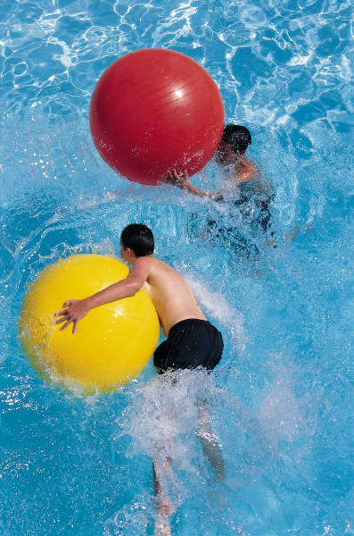
My favorite food is:pizza
My favorite color:blue
My favorite subject is:reading
When I grow up I want to be:police
I love it when my parents:care about me
I hate it when my parents:hit me
My pet peeve is:when my sister doesen’t tell the truth
The best thing about me is:being nice

Slide 40
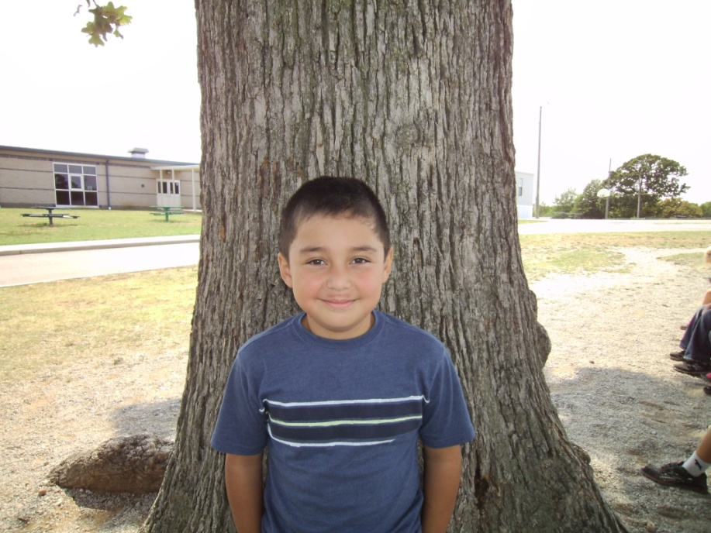
Angel Reinado Velasquez
Age:8
Birthday: April 20
Family: Dad mom Andy Jason Kike
My hobbies are: playing the x box playing soccer

Slide 41
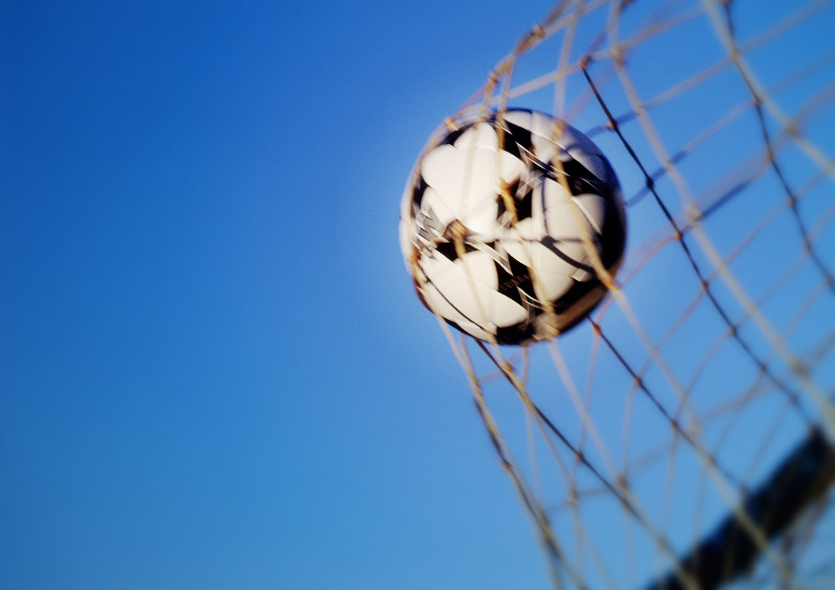
My favorite food is: pizza
My favorite color: blue
My favorite subject is: math
When I grow up I want to be: Doctor
I love it when my parents: think
I hate it when my parents: make me do everything
My pet peeve is: when they tell me to do everything
The best thing about me is: I help my mom

